Slide 1
McKenzie Summary
History and Early Outplanting
McKenzie historically most productive Upper Willamette River (UWR) tributary for spring Chinook
still produces the majority of NOR spring Chinook
Spawning habitat blocked on two tribs (South Fork and Blue River) and one the mainstem by high head dams
Cougar Dam built 1964, no passage, blocks 40km of prime spawning habitat on the South Fork
Early outplanting efforts abandoned due to low returns. Assumed cause: low downstream passage survival
Began outplanting of HOR salmon from the mainstem above Cougar Dam in 1993 to restore historical ecosystem functions
NORs suspected to be produced above the dam start returning in greater numbers prompting ->
In 2011 a new trap and haul facility opens at the base of the Dam
Releasing NORs above the dam

Slide 2
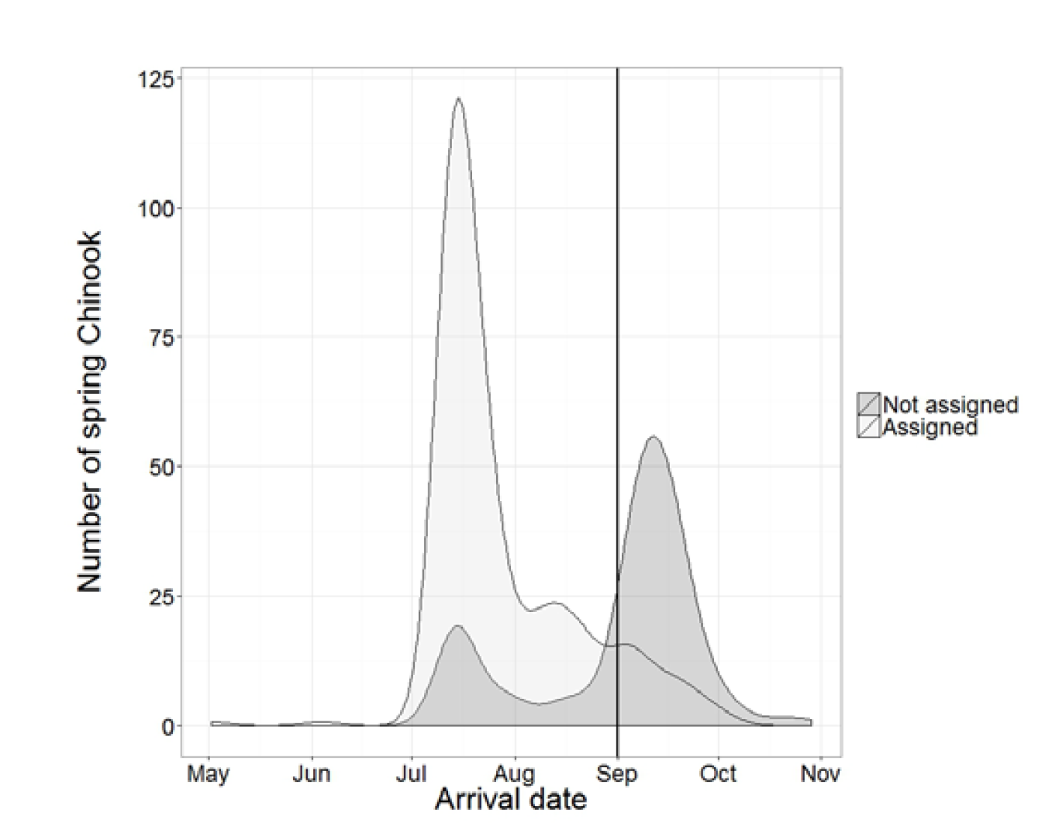
McKenzie Summary
LSDR and Previous Evaluations
First genetic pedigree study 2013
Assigns potential offspring (NOR salmon collected at Cougar trap as well as NOR juveniles collected at screw traps above and below the reservoir) to candidate parents (all NOR and HOR salmon released above the dam)
Most (BUT NOT ALL) NOR salmon collected at the trap are produced above the dam
NOR salmon at the trap arrive in two waves
early: mostly produced above the dam
late: mostly “NOR immigrants” (NORs not assigned to a parent above the dam and presumed produced below the dam or elsewhere)
CRR (number of spawners produced by a spawner) is << 1. CRR = 0.38

Slide 3
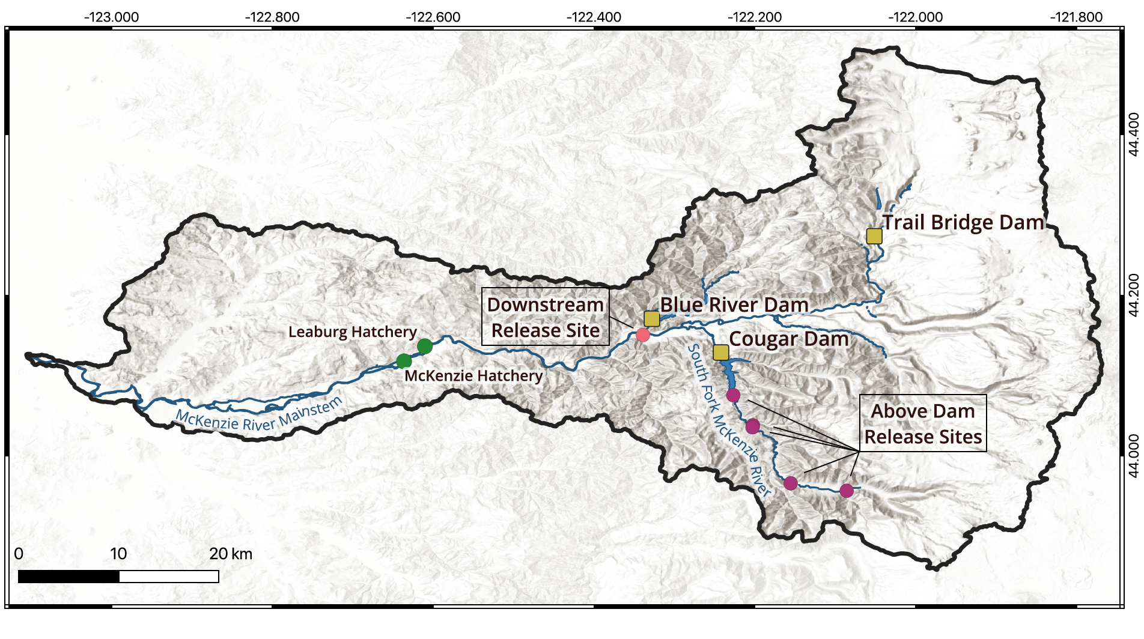
McKenzie Summary
LSDR and Previous Evaluations
These two findings (NOR immigrants compose the majority of late arriving NORs and CRR is less than one), were predicted by managers
Implemented late-season downstream release (LSDR)

Slide 4
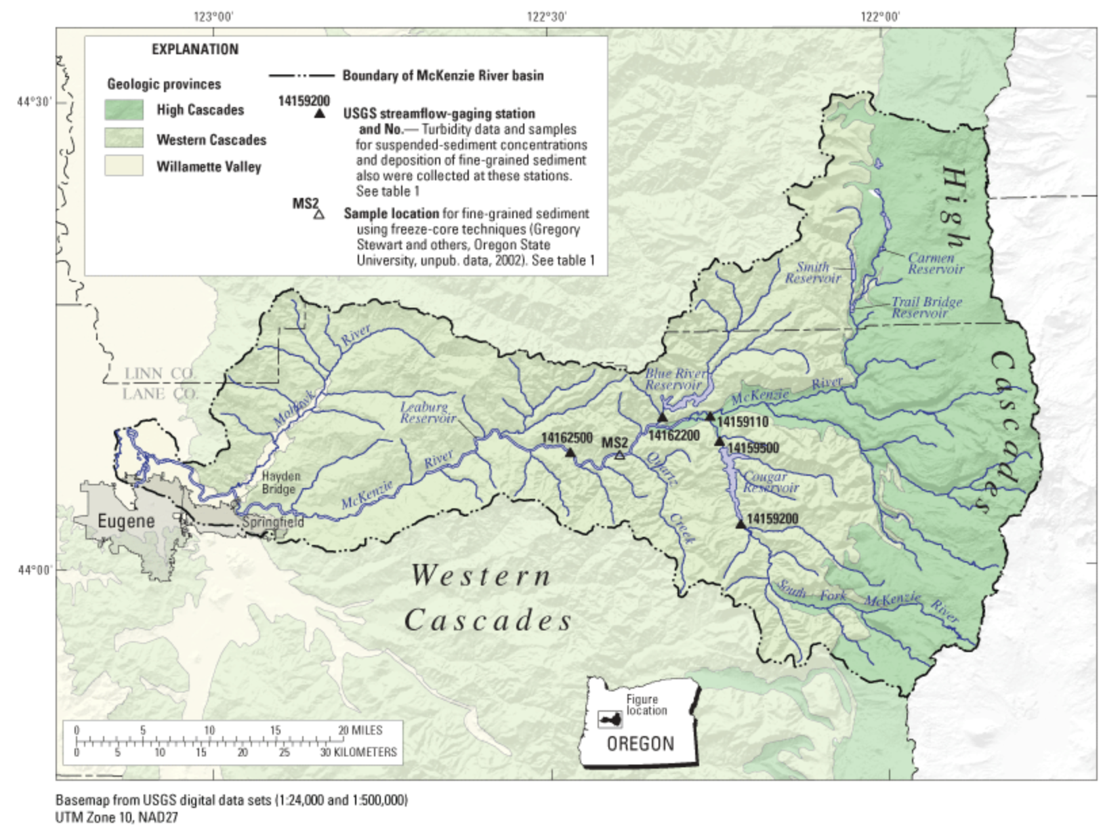
McKenzie Summary
LSDR and Previous Evaluations
These two findings (NOR immigrants compose the majority of late arriving NORs and CRR is less than one), were predicted by managers
Implemented late-season downstream release (LSDR)
“Intended to prevent transportation of NOR Chinook that were not produced above Cougar Dam ”
High Head Dams
McKenzie and Leaburg Hatcheries
Downstream Release Site

Slide 5
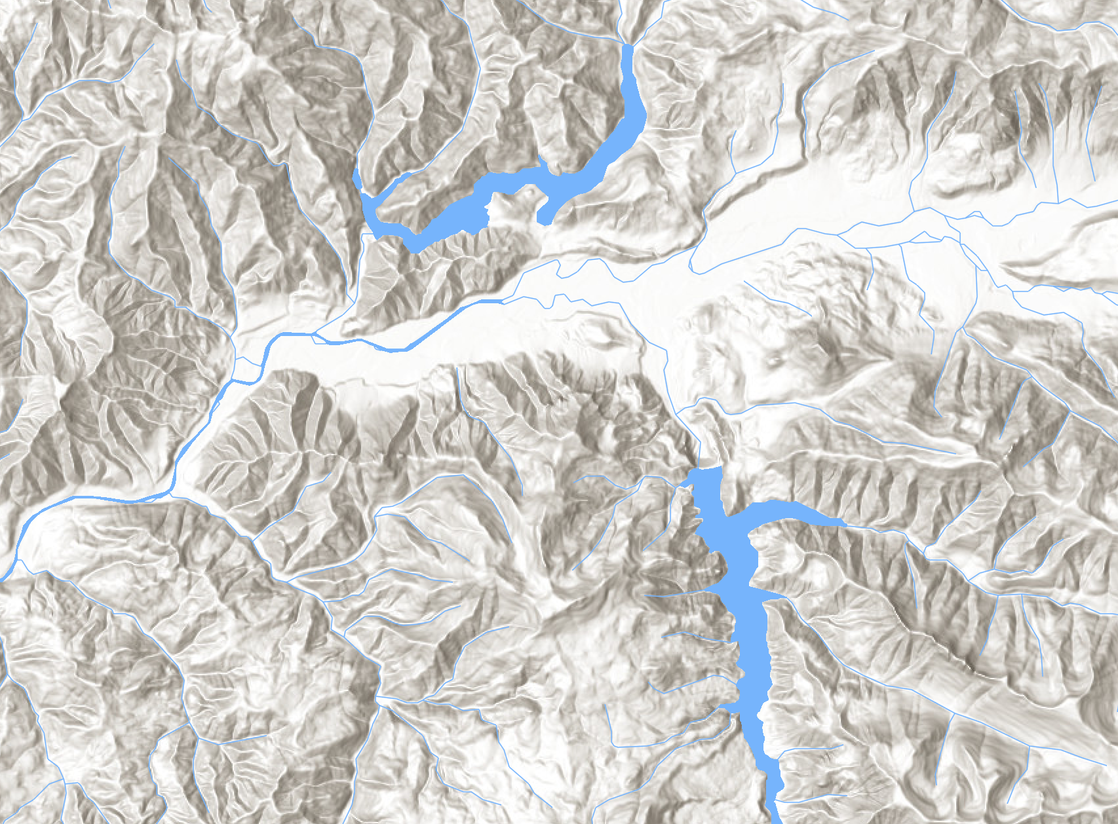
McKenzie Summary
LSDR and Previous Evaluations
LSDR: 2013 and 2014
All NOR after Sept 1
Recycling: 2015 -
All NOR, regardless of date
Blue River Dam
Mainstem McKenzie
Downstream Release Site
Cougar Dam
Cougar Reservoir

Slide 6
McKenzie Summary
LSDR and Previous Evaluations
Genetic Pedigree Studies 2014 and 2016
Parent Years 2007 – 2010
LSDR
More NOR immigrants later
selectively prevents release of NOR immigrants
CRR << 1
Fitness differences between NOR and HOR parents
NORmale > HORmale - strong evidence
NORfemale > HORfemale - weaker evidence
Recommendations:
Prioritize release of NOR salmon
Judiciously supplement with HOR females where necessary to reach demographic targets
Reduce outplanting of HOR males
Continue LSDR
Carefully weigh costs and benefits of releasing NOR immigrants
Caveat: Fitness difference need to be confirmed

Slide 7
McKenzie Summary
LSDR and Previous Evaluations
Genetic Pedigree Studies 2014 and 2016
Parent Years 2007 – 2010
LSDR
More NOR immigrants later
selectively prevents release of NOR immigrants
CRR << 1
Fitness differences between NOR and HOR parents
NORmale > HORmale - strong evidence
NORfemale > HORfemale - weaker evidence
Recommendations:
Prioritize release of NOR salmon
Judiciously supplement with HOR females where necessary to reach demographic targets
Reduce outplanting of HOR males
Continue LSDR
Carefully weigh costs and benefits of releasing NOR immigrants
Caveat: Fitness difference need to be confirmed

Slide 8
2022 Report Data
Parents: 2007 – 2017
Offspring: 2010 – 2020
Final
Location
Source
Origin
45
10
5
14
24
31
13
35
15
SGS
NOR
Below*
51
59
106
124
88
52
93
73
Cougar Trap
NOR
Below
221
356
500
172
132
135
171
151
68
65
89
Cougar Trap
NOR
Above
30
29
17
15
20
19
70
5
Cougar Trap
HOR
Above
Hatchery Outplant
HOR
Above
745
873
1383
496
340
430
440
486
600
459
448
2007
2008
2009
2010
2011
2012
2013
2014
2015
2016
2017
2018
2019
2020

Slide 9
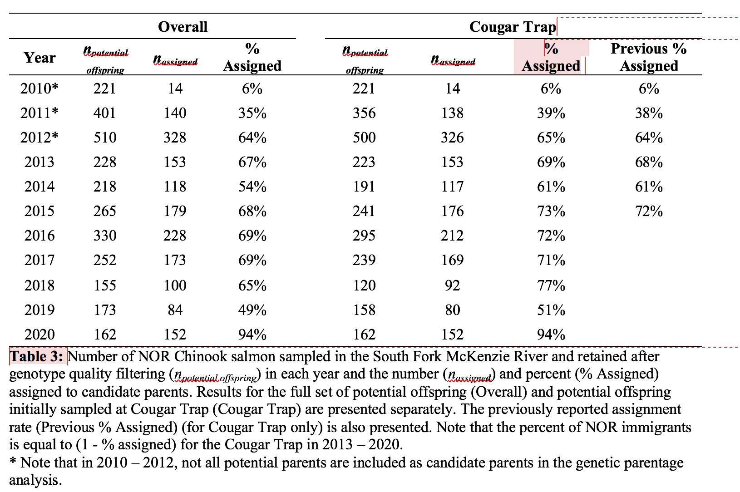
Assignments
Rates
Absolute difference in assignment rate = 0.7%
Most (71%) NOR salmon collected at the Cougar Trap from 2013 - 2020 were produced above Cougar Dam. Leaving 29% remaining as likely immigrants.
The proportion of NOR immigrants collected at the Cougar Trap varied among years. As many as 49% and as few as 6% of NOR salmon collected at the Cougar Trap were immigrants in 2019 and 2020, respectively

Slide 10
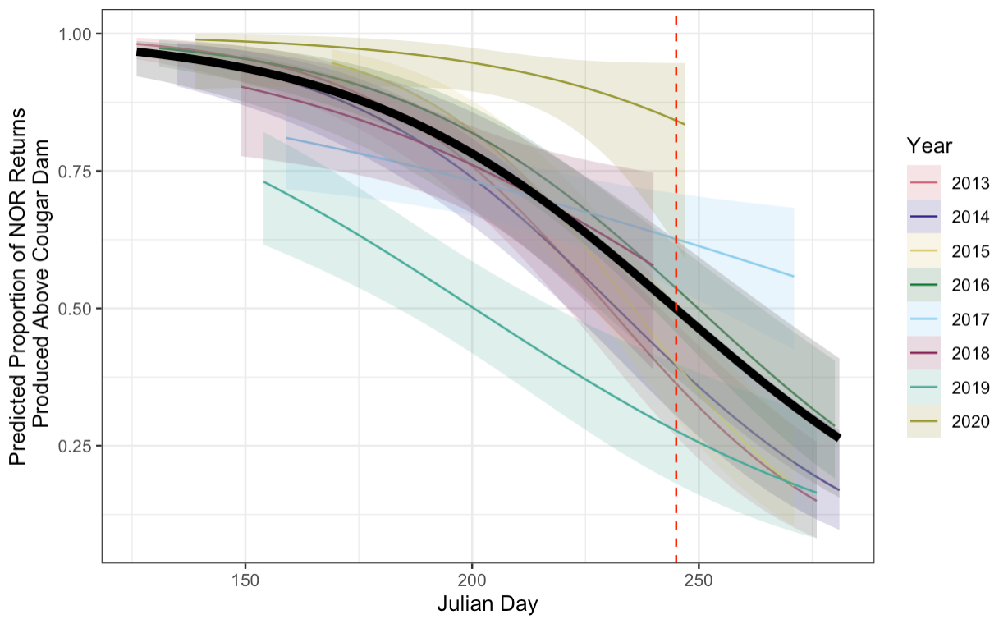
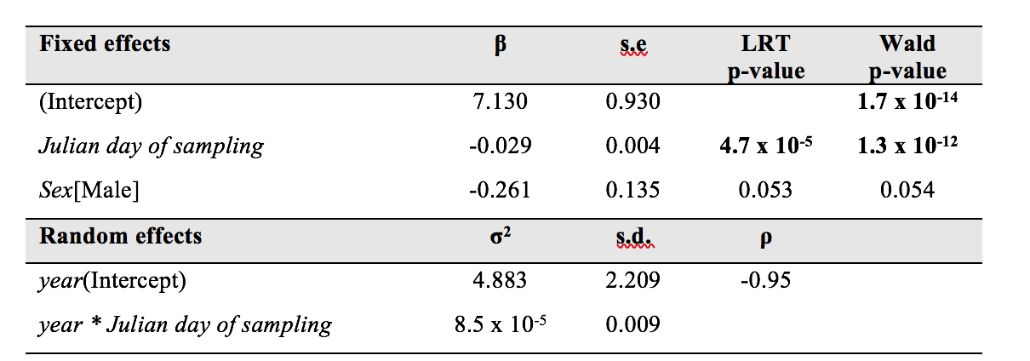
Assignments
NOR Immigrants
The proportion of NOR immigrants collected at Cougar Trap was estimated to increase from less than 5% early in the season to ~50% by September 1st.
However, there was substantial variation among years in the relationship between time and the proportion of NOR immigrants collected at Cougar Trap

Slide 11
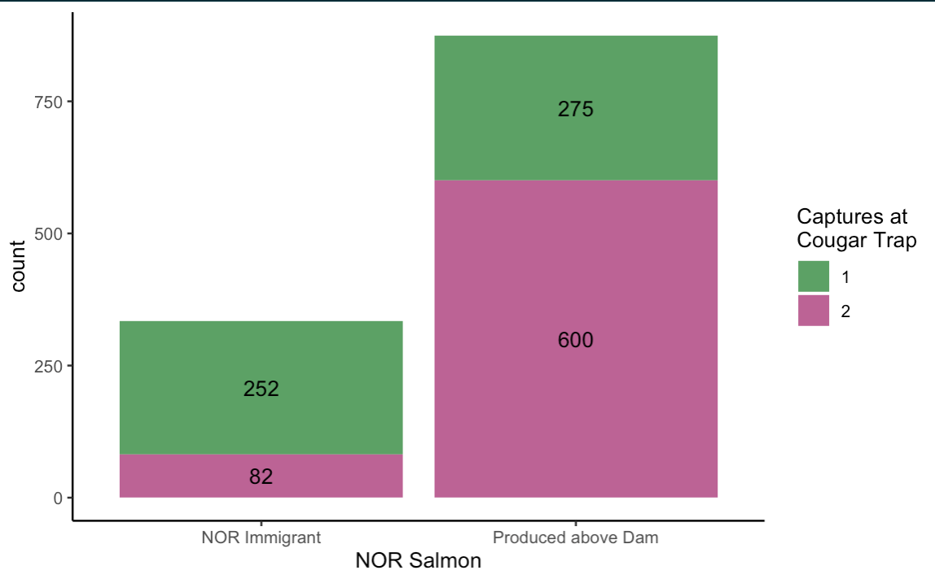
Assignments
Evaluating Recycling
From 2015 – 2020, a salmon produced above the dam was more likely to return a second time after being recycled downstream than an NOR immigrant.
Recycling all salmon collected at the Cougar Trap downstream during this period prevented above dam transport of 75% of NOR immigrants and 31% of NOR salmon produced above the dam.
LSDR during the same period (2015 – 2020) would have prevented above dam transport of only 47% of NOR immigrants and 5% of NOR salmon produced above the dam

Slide 12
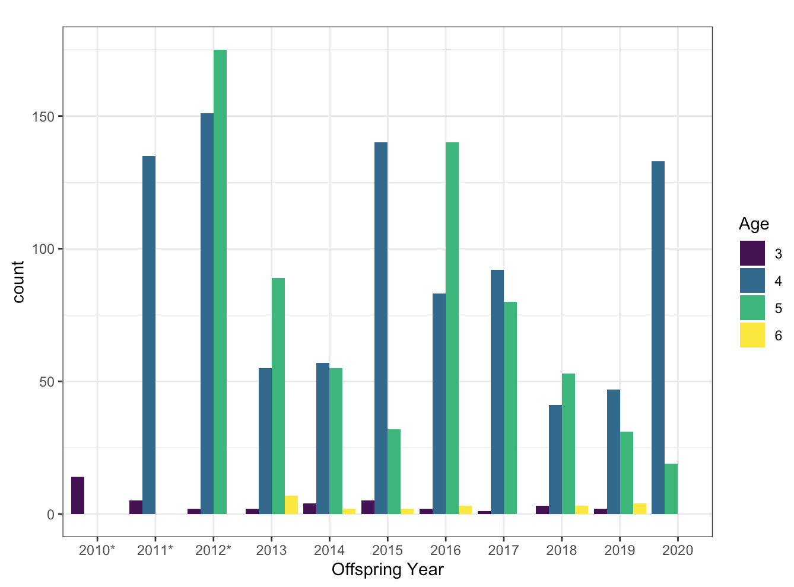
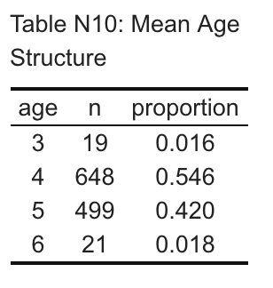
Demography
Age Structure

Slide 13
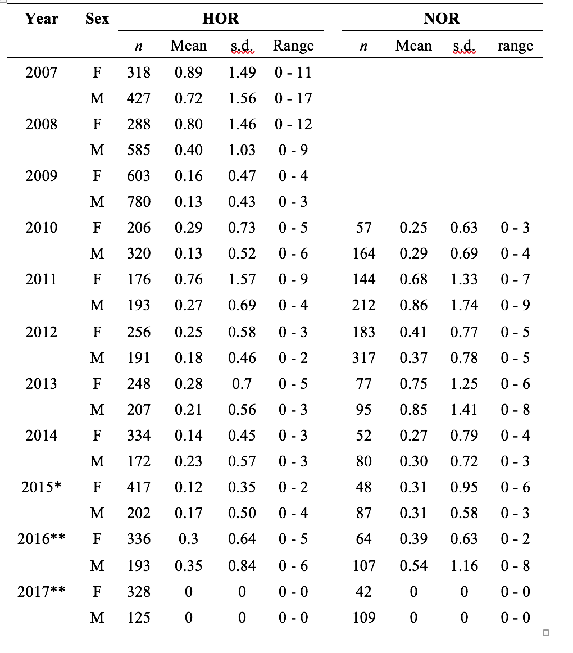
Demography
TLF

Slide 14
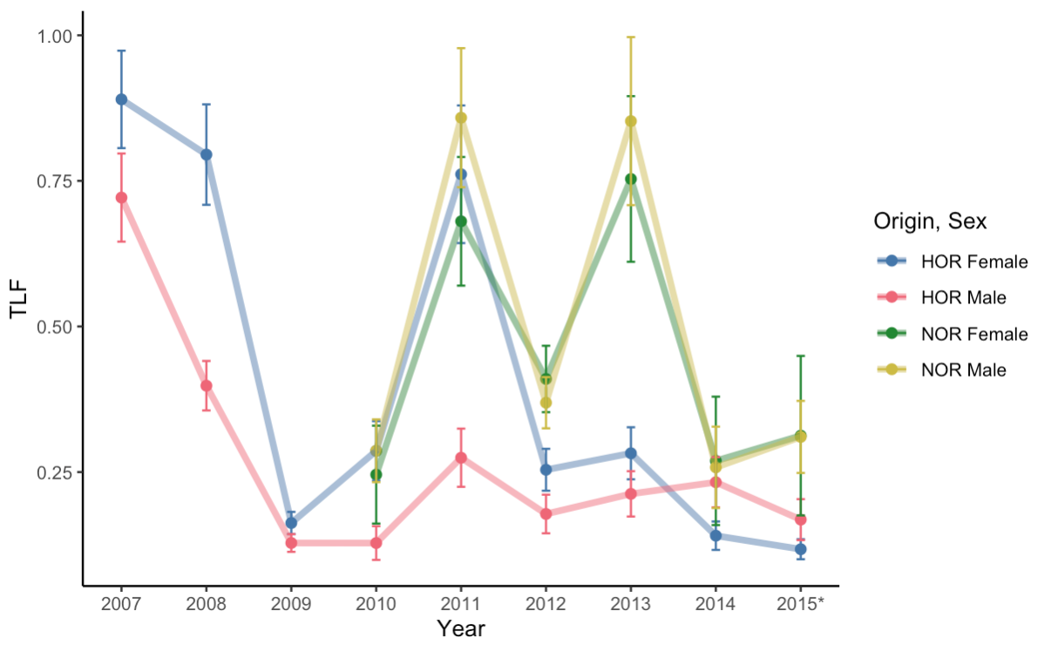
Demography
TLF
Mean TLF was 0.36. Varied a lot between years.
TLF was highly variable at the individual level and ranged 0 - 17.
Mean TLF was greater for NOR than HOR salmon (0.49 vs. 0.32, respectively) and for females than males (0.38 vs. 0.34).

Slide 15
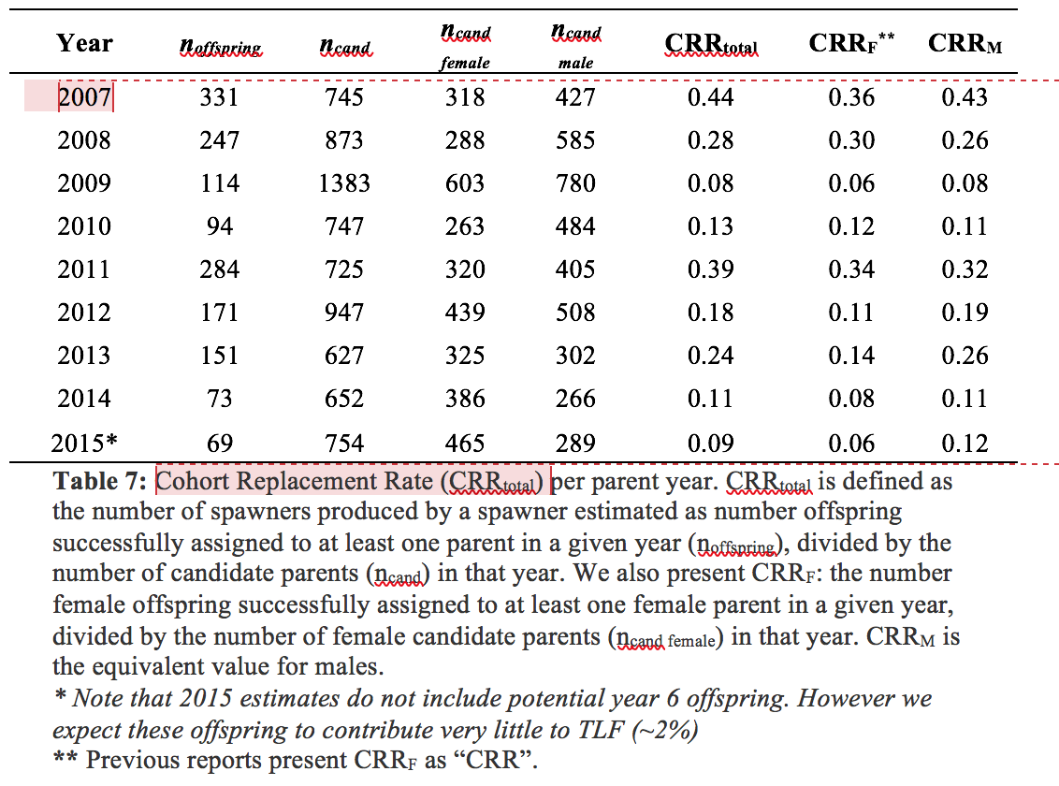
Demography
CRR
CRRtotal never approached one, indicating that population above the dam is not replacing itself.
Maximum CRRtotal was 0.44 and minimum was 0.08.
In most years females were the limiting sex. CRRF was less than one in these years. In years when males were the limiting sex, CRRM was also less than one

Slide 16
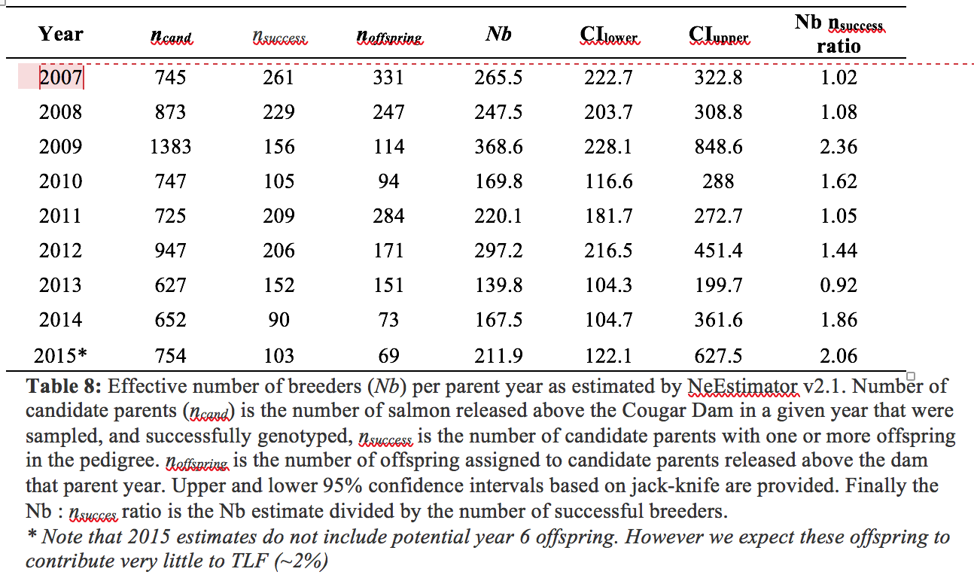
Demography
Nb
Nb ranged from 139.8 to 368.8, indicating that there is likely sufficient genetic diversity within a parental cohort to avoid inbreeding depression.

Slide 17
Fitness Modeling
GLMM Model Selection
GLMM: 9 years (2007 - 2015)
Predictors
sex
origin
release day (NL)
release location
release group density (NL)
release group sex ratio (NL)
annual sex ratio (NL)
sex*release day
sex*origin
sex*annual sex ratio
(1 | release group)
(1 | year)

Slide 18
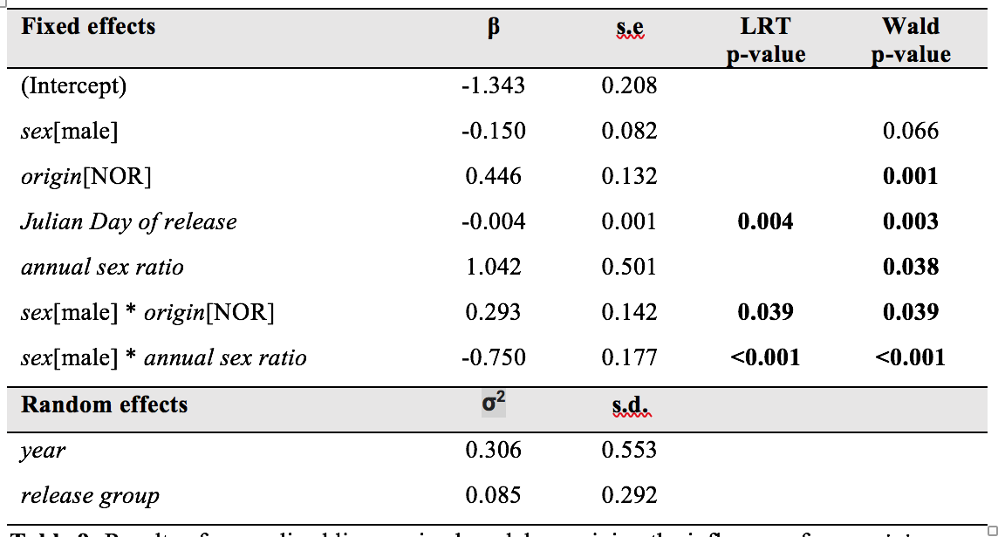
Fitness Modeling
GLMM Results
GLMM: 9 years (2007 - 2015)
Predictors
sex
origin
release day (NL)
release location
release group density (NL)
release group sex ratio (NL)
annual sex ratio (NL)
sex*release day
sex*origin
sex*annual sex ratio
(1 | release group)
(1 | year)

Slide 19
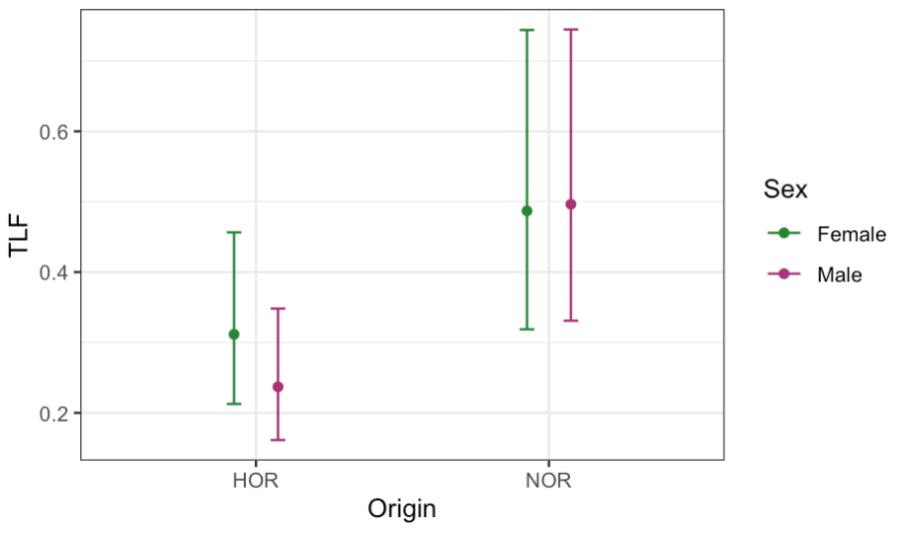
Fitness Modeling
Estimated Effects
NOR males are predicted to be 2.1 fold more fit the HOR males
NOR females are predicted to be 1.6 fold more fit than HOR females.

Slide 20
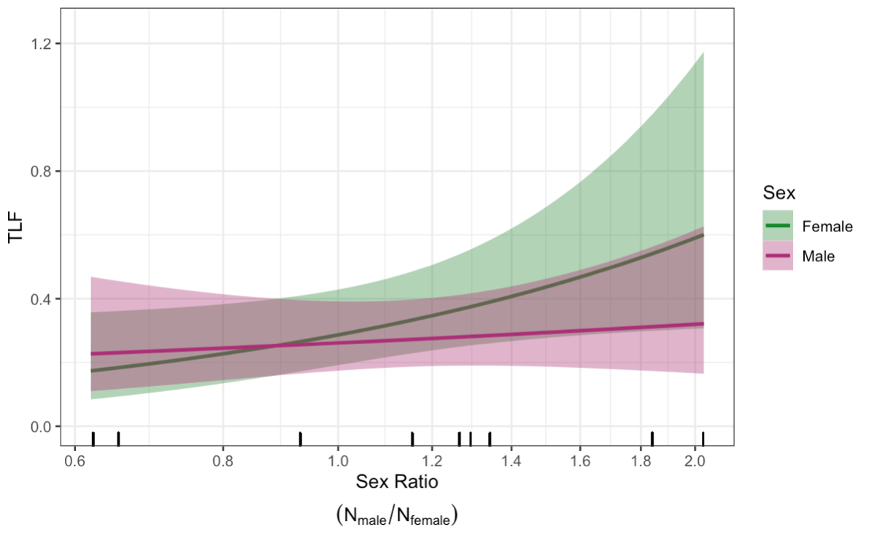
Fitness Modeling
Estimated Effects
Overall: marginally significant
Changes in annual sex ratio affects fitness mostly through females, who perform worse when the sex ratio is female biased
Using the most extreme values in observed in any years (male:female ratio 0.6 and 2.0)
female fitness is predicted to vary 3.5 fold
male fitness is expected to vary 1.4 fold

Slide 21
(1) The overall range of sex ratios between the McKenzie and North Santiam reports is similar. (0.6 to 2.0) vs (0.8 to 2.0)
(2) But, there are more years included in the model for McKenzie than for North Santiam (9 versus 5), and there is only one year with a female biased sex ratio in the North Santiam.
(3) Similar numbers of salmon are released above the dams on average, but the percent of HOR spawners released above Cougar Dam varies from 47% - 100%. In contrast, with the exception of one year, all salmon released above Detroit Dam were HOR
(4) It seems like salmon released above Cougar Dam dispersed after release much more than those released above Detroit Dam. This is very back of the napkin stuff, but for the 1258 mate pairs identified in the McKenzie pedigree, 571 (55%) were between salmon released in different locations, but in the North Santiam only 1789/2220 (19%) mate pairs were between individuals released in different locations, despite the fact that there are many more release sites in the North Santiam.
My suspicion is that either the North Santiam result is spurious, or the sex ratio effect is mediated by the either the pHOS or the ability for spawners to disperse, but I’m not sure we can do much more than speculate here.

Slide 22
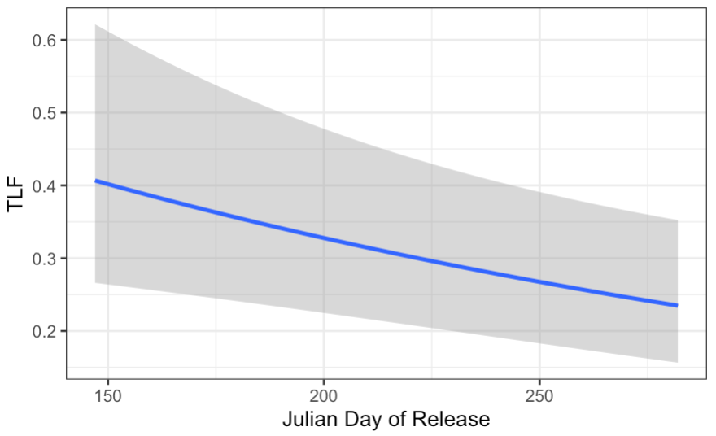
Fitness Modeling
Estimated Effects
Salmon released above Cougar Dam earlier in the season are predicted to have greater fitness than those released later.
Individuals released on the earliest day in the dataset are predicted to have 1.7 fold greater fitness than the latest release day.

Slide 23
Discussion
LSDR and Recycling
Remember:
CRR is less than 1 in all years
NOR fitness is greater than HOR fitness
Motivation of LSDR and recycling is contentious
Given 1 and 2, costs and benefits of recycling accrue differently to the above and below dam populations
Above Dam
NOR salmon produced above the dam can contribute to the future productivity of their source population
NOR salmon are more fit than their HOR counterparts above the dam, therefore decreasing the proportion of HOR spawners above the dam is expected to improve productivity per salmon released
Transport of NOR immigrants may uniquely contribute to the standing genetic variation of the above dam population.
Delayed release (31 days = 12% reduction in TLF)
Additional handling and migration, unquantified
Below Dam
Above dam transport of NOR salmon, regardless of whether they are produced above the dam or not, presumably negatively influences NOR production basin wide, because the above dam habitat is a net demographic sink

Slide 24
Discussion
Fitness Effects

Slide 25
Other Results
Reversal Of Hatchery Effects, Rapid?
Negative hatchery effects on fitness take only a generation to develop: both plasticity and selection
But how long does it take to reverse these effects, and can we parse plastic from genetic effects?
Also, are there differences in genetic diversity among HOR, NOR produced above, or NOR immigrants?
What is TLF for:
directly after captive breeding with no selection in the wild (generation zero, hatchery outplants)
after 1 generation (F1s) (parents HORxHOR, but hatchery outplants)
after 2 generations (F2s) (parents NORxNOR)

Slide 26
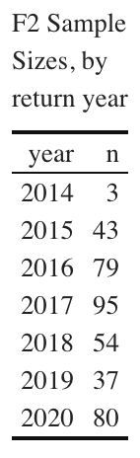
Other Results
Reversal Of Hatchery Effects, Rapid?
Insufficient F2s to parse plastic from genetic hatchery effects
Negative hatchery effects on fitness take only a generation to develop: both plasticity and selection
But how long does it take to reverse these effects, and can we parse plastic from genetic effects?
Also, are there differences in genetic diversity among HOR, NOR produced above, or NOR immigrants?
What is TLF for:
directly after captive breeding with no selection in the wild (generation zero, hatchery outplants, unknown parents)
after 1 generation (F1s) (parents HORxHOR, but hatchery outplants)
after 2 generations (F2s) (parents NORxNOR)
Insufficient data:
46 F2s in 2014 and 2015
Given the extraordinary variance in TLF this is insufficient to address the question with any power
AAM of 4/5 years prevents us from using the 79, 95, … in later years. By 2025 we will have F2 TLF estimates for 391 individuals.

Slide 27
Other Results
Reversal Of Hatchery Effects, Rapid?
Negative hatchery effects on fitness take only a generation to develop: both plasticity and selection
But how long does it take to reverse these effects, and can we parse plastic from genetic effects?
Also, are there differences in genetic diversity among HOR, NOR produced above, or NOR immigrants?
What is TLF for:
directly after captive breeding with no selection in the wild (generation zero, hatchery outplants)
after 1 generation (F1s) (parents HORxHOR, but hatchery outplants)
after 2 generations (F2s) (parents NORxNOR)
But we do have enough F1s:
most of the 157 parents in NxN crosses presented in slide 29 are F1s
NxN crosses are significantly more fit than HxH crosses (see slide 29)

Slide 28
Other Results
pHOS reduces NOR fitness?
Higher fitness of F1s descended from NORxNOR crosses than from NORxHOR indicates that supplementation with HOR outplants reduces the fitness of NOR reintros
What is the relative reproductive success of the different crosses (female x male), relative to NxN?
H x H:
H x N:
N x H:

Slide 29
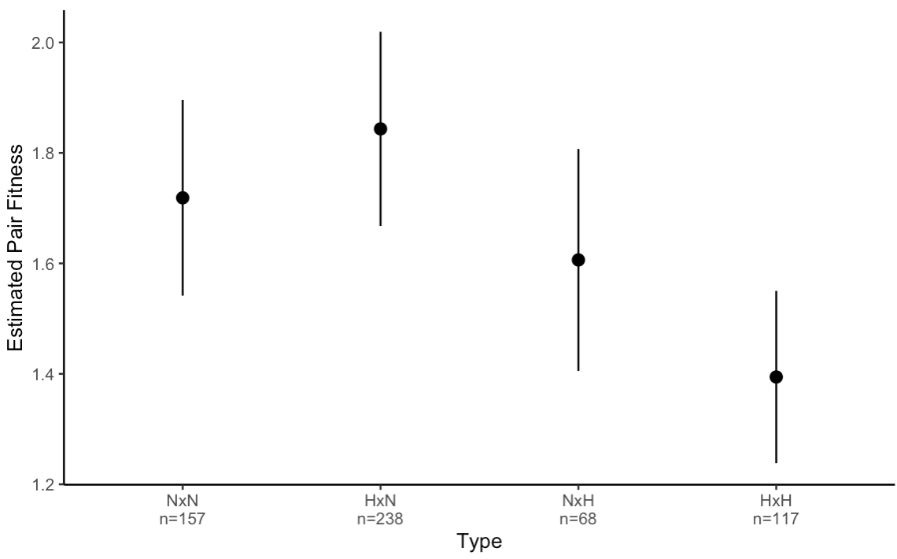
Other Results
pHOS reduces NOR fitness?
Higher fitness of F1s descended from NORxNOR crosses than from NORxHOR indicates that supplementation with HOR outplants reduces the fitness of NOR reintros
What is the relative reproductive success of the different crosses (female x male), relative to NxN?
H x H: 0.81*
H x N: 1.07
N x H: 0.93
So with the current data, and a still preliminary
analysis:
HxH is less fit than NxN (p = 0.03)
HOR male reduces fitness of NOR female,
but NS (p = 0.3) and smaller samples size
(presumably because of mate choice against
HOR males see next slide!)
(3) HOR female does NOT reduce fitness of
NOR male
preliminary

Slide 30
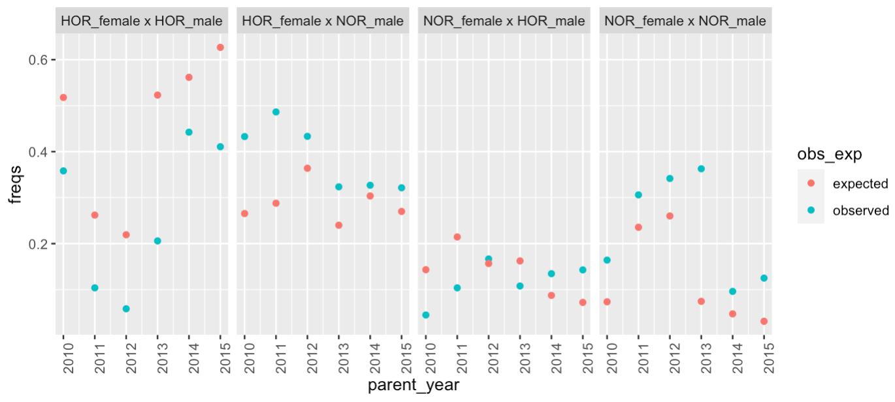
Another way of looking at the issue: Given the proportions of NOR and HOR males and females, what is the expected frequency of cross type (red) we expect in the pedigree in a given year, and how does this compare to the observed frequencies.
Think of the above like a HWE test. In all years, the observed and expected frequencies of cross types are significantly different!

Slide 31
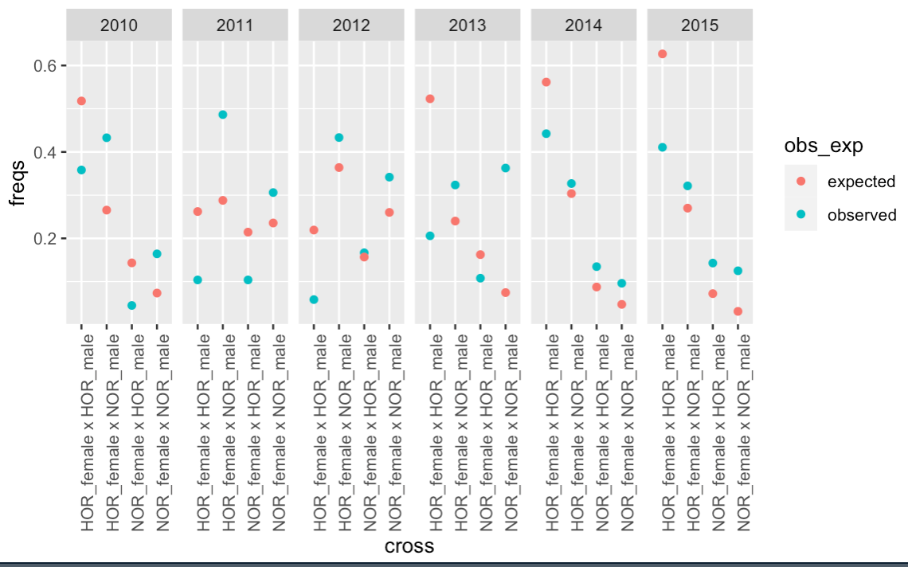
Same data as previous slide, but different way of organizing figure

Slide 32
In all years there are fewer HORxHOR (female x male), and more HORxNOR and NORxNOR mate pairs than expected given the frequencies of HOR and NOR males and females. However the observed number of NORxHOR is not different the random expectation in any consistent pattern
So, does this tells us that lower fitness HOR males are reducing the fitness of the NOR females they spawn with? Not so sure, because the pattern above may just result from sexual selection. Fewer HOR males are successfully spawning than expected, but the data in the figure (TLF) includes the effects of both mate choice and origin based fitness effects (mate pairs are counted three times if they produce 3 offspring, for example).

